Slide 1

State Management

Slide 2
Content
State Management
  View State
  Cross-Page Posting
  Query String
  Cookies
  Session State
  Application State
Anadolu University

Slide 3
State Management
The most significant difference between programming for the web and the desktop
State management determines how you store information over the lifetime of the application
This information can be as simple as a user’s name, or as complex as a stuffed-full shopping cart
In a traditional Windows application, memory is always available and only one user is considered
In web applications, thousands of users can simultaneously run the same application on the same computer
Anadolu University

Slide 4
State Management Options
View State
Query String
Cookies
Session State
Application State
Anadolu University

Slide 5
The Problem of State
In a typical web request, the client connects to the web server and requests a web page
When the page is delivered, the connection is closed and the web server abandons any information it has about the client
By the time the user receives the page, there is no information left in the web server’s memory
Advantage: Web server can handle a huge number of simultaneous requests
Disadvantage: You need to take additional steps in order to retain information
Anadolu University

Slide 6
View State
One of the most common place to store information
Web controls whose EnableViewState property is set to true (which is default) automatically use view state
However view state is not limited to web controls
You can directly add information to view state and retrieve it after the page is posted back
Anadolu University

Slide 7
The ViewState Collection
ViewState property is a StateBag collection
This means that every item is stored using a unique string name
Adding an item to ViewState:
  this.ViewState[“Counter”] = 1;
Retrieving an item:
  int counter = (int)this.ViewState[“Counter”];
  Make sure that the key exists in the ViewState!
  Don’t forget type casting!
The keyword “this” is optional, you can omit it
This syntax is valid for other .NET collections
Anadolu University

Slide 8
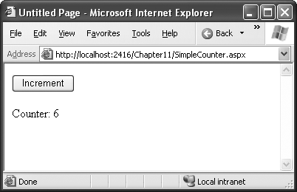
A ViewState Example
Anadolu University

Slide 9
A ViewState Example
public partial class SimpleCounter : System.Web.UI.Page
{
protected void cmdIncrement_Click(Object sender, EventArgs e)
{
int counter;
if (ViewState["Counter"] == null)
{
counter = 1;
}
else
{
counter = (int)ViewState["Counter"] + 1;
}
ViewState["Counter"] = counter;
lblCount.Text = "Counter: " + counter.ToString();
}
}
Anadolu University

Slide 10
Retaining Member Variables
Any information set in a member variable for an ASP.NET page is automatically abandoned
You can overcome this problem by using ViewState
Retrieve the value in Page.Load event
Store the value into ViewState in Page.PreRender event
Anadolu University

Slide 11
Retaining Member Variables
protected void Page_Load(Object sender, EventArgs e)
{
if (this.IsPostBack)
{
// Restore variables.
contents = (string)ViewState["contents"];
}
}
protected void Page_PreRender(Object sender, EventArgs e)
{
// Persist variables.
ViewState["contents"] = contents;
}
Anadolu University

Slide 12
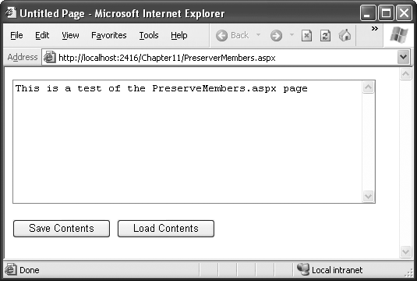
Retaining Member Variables
Anadolu University

Slide 13
Retaining Member Variables
protected void cmdSave_Click(Object sender, EventArgs e)
{
// Transfer contents of text box to member variable.
contents = txtValue.Text;
txtValue.Text = "";
}
protected void cmdLoad_Click(Object sender, EventArgs e)
{
// Restore contents of member variable to text box.
txtValue.Text = contents;
}
Anadolu University

Slide 14
Attention!
Don’t store needless amount of information into ViewState
Otherwise:
  The size of the final HTML page will be enlarged
  Page transmission is slowed down
Disadvantages:
  You may forget to put some parts of the code in Page.Load or Page.PreRender events
  Other programmers may be confused
Anadolu University

Slide 15
Advanced Topics…
ViewState is not secure but you can make it secure
  enableViewStateMac, ViewStateEncriptionMode, RegisterRequiresViewStateEncryption, …
You can store your custom objects into ViewState using [Serializable] attribute
Anadolu University

Slide 16
Transferring Information Between Pages
View state is tightly bounded to a specific page
If the user navigates to another page, ViewState information is lost
Two basic solutions to this problem are:
  Cross-page posting (don’t use)
  Query string
Anadolu University

Slide 17
Cross-Page Posting (don’t use)
The controls Button, LinkButton, and ImageButton have a property PostBackUrl
When the button is clicked, all information in the current page are sent to that page
This technique sounds conceptually straightforward, but it’s a potential minefield
If you are not careful, it can lead you to create pages that are tightly coupled to others and difficult to enhance and debug
Don’t use this technique unless you know what it exactly is and you are sure that you need it!
Anadolu University

Slide 18
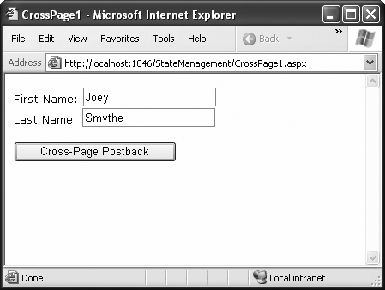
Cross-Page Posting (don’t use)
PostBackUrl is CrossPage2.aspx
Anadolu University

Slide 19
Cross-Page Posting (don’t use)
public partial class CrossPage2 : System.Web.UI.Page
{
protected void Page_Load(object sender, EventArgs e)
{
if (PreviousPage != null)
{
lblInfo.Text = "You came from a page titled " +
PreviousPage.Title;
}
}
}
Anadolu University

Slide 20
Cross-Page Posting (don’t use)
You can get the CrossPage1 object in CrossPage2 as:
  CrossPage1 prevPage = PreviousPage as CrossPage1;
If you want to get some information from CrossPage1, define a property in CrossPage1:
  public string FullName
  {
  get{ return txtFirstName.Text + “ ” + txtLastName.Text; }
  }
Get this value in CrossPage2:
  lblInfo.Text = prevPage.FullName;
Anadolu University

Slide 21
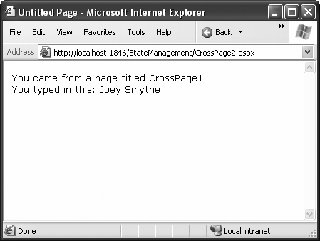
Cross-Page Posting (don’t use)
Anadolu University

Slide 22
Query String
Another common approach is to pass information using a query string in the URL
http://www.google.com/search?q=organic+gardening
Advantages:
  Query string is lightweight
  Does not exert any kind of burden on the server
Anadolu University

Slide 23
Disadvantages of Query String
Information is limited to simple strings, which must contain URL-legal characters
Information is clearly visible to the user and anyone else who cares an eavesdrop on the Internet
The user may change query string
Many browsers impose a limit on the length of a URL, so large amount of information cannot be placed on query string
Anadolu University

Slide 24
Use of Query String
Put a hyperlink with link “newpage.aspx?recordID=10”
Response.Redirect(“newpage.aspx?recordID=10”);
Response.Redirect(“newpage.aspx?recordID=10&mode=full”);
Retrieve the value by Request.QueryString:
  string id = Request.QueryString[“recordID”];
  Information is always string
  Check for null reference
Information is visible and unencrypted
Anadolu University

Slide 25
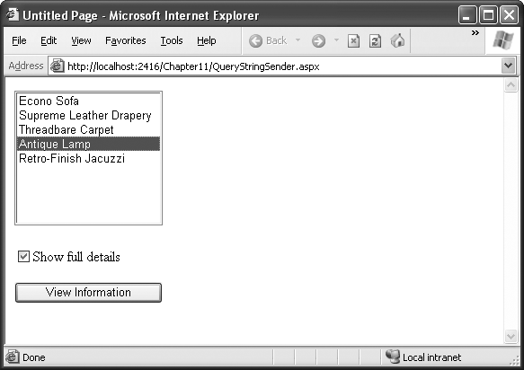
A Query String Example
Anadolu University

Slide 26
QueryStringSender Class
public partial class QueryStringSender : System.Web.UI.Page
{
protected void Page_Load(Object sender, EventArgs e)
{
if (!this.IsPostBack)
{
// Add sample values.
lstItems.Items.Add("Econo Sofa");
lstItems.Items.Add("Supreme Leather Drapery");
lstItems.Items.Add("Threadbare Carpet");
lstItems.Items.Add("Antique Lamp");
lstItems.Items.Add("Retro-Finish Jacuzzi");
}
}
Anadolu University

Slide 27
QueryStringSender Class
protected void cmdGo_Click(Object sender, EventArgs e) {
if (lstItems.SelectedIndex == -1) {
lblError.Text = "You must select an item.";
}
else {
// Forward the user to the information page,
// with the query string data.
string url = "QueryStringRecipient.aspx?";
url += "Item=" + lstItems.SelectedItem.Text + "&";
url += "Mode=" + chkDetails.Checked.ToString();
Response.Redirect(url);
}
}
}
Anadolu University

Slide 28
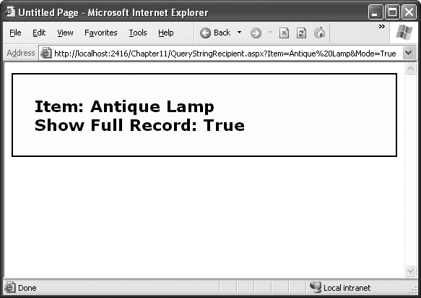
QueryStringRecipient Page
Anadolu University

Slide 29
QueryStringRecipient Class
public partial class QueryStringRecipient : System.Web.UI.Page
{
protected void Page_Load(Object sender, EventArgs e)
{
lblInfo.Text = "Item: " + Request.QueryString["Item"];
lblInfo.Text += "<br />Show Full Record: ";
lblInfo.Text += Request.QueryString["Mode"];
}
}
Anadolu University

Slide 30
URL Encoding
You see “%20” instead of space characters in the URL
This is because space characters are encoded into “%20”
Special characters should be encoded for URL:
  string url = "QueryStringRecipient.aspx?";
  url += "Item=" + Server.UrlEncode(lstItems.SelectedItem.Text) + "&";
  url += "Mode=" + chkDetails.Checked.ToString();
  Response.Redirect(url);
URL decode is not necessary for query string
Anadolu University

Slide 31
Cookies
Cookies are small files that are created on the client’s hard drive
They can be easily used by any page in the application
They can be retained between visits, which allows for truly long-term storage
They are limited to simple strings
They are easily accessible and readable
Some users disable cookies on their browsers
Users can manually delete cookies
Anadolu University

Slide 32
Using Cookies
Import System.Net namespace:
  using System.Net;
Both the Request and Response objects provide a Cookies collection
You retrieve cookies from Request object and set cookies using Response object
To create a longer-lived cookie, set an expiration date
Anadolu University

Slide 33
Setting Cookies
// Create the cookie object.
HttpCookie cookie = new HttpCookie("Preferences");
// Set a value in it.
cookie["LanguagePref"] = "English";
// Add another value.
cookie["Country"] = "US";
// Set an expiration date:
cookie.Expires = DateTime.Now.AddYears(1);
// Add it to the current web response.
Response.Cookies.Add(cookie);
Anadolu University

Slide 34
Retrieving Cookies
HttpCookie cookie = Request.Cookies["Preferences"];
// Check to see whether a cookie was found with this name.
// This is a good precaution to take, because the user could
// disable cookies, in which case the cookie will not exist.
string language;
if (cookie != null)
{
language = cookie["LanguagePref"];
}
Anadolu University

Slide 35
Removing A Cookie
The only way to remove a cookie is by replacing it with a cookie that has an expiration date that has already passed
  HttpCookie cookie = new HttpCookie("LanguagePref");
  cookie.Expires = DateTime.Now.AddDays(-1);
  Response.Cookies.Add(cookie);
Anadolu University

Slide 36
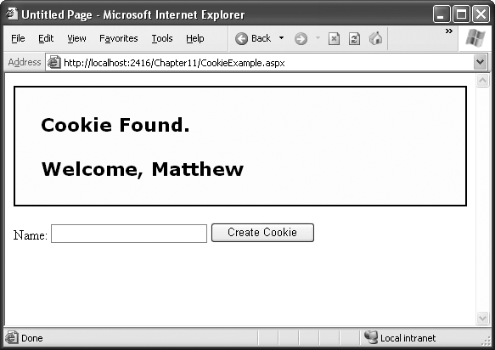
A Cookie Example
Anadolu University

Slide 37
public partial class CookieExample : System.Web.UI.Page
{
protected void Page_Load(Object sender, EventArgs e)
{
HttpCookie cookie = Request.Cookies["Preferences"];
if (cookie == null)
{
lblWelcome.Text = "<b>Unknown Customer</b>";
}
else
{
lblWelcome.Text = "<b>Cookie Found.</b><br /><br />";
lblWelcome.Text += "Welcome, " + cookie["Name"];
}
}
Anadolu University

Slide 38
protected void cmdStore_Click(Object sender, EventArgs e)
{
// Check for a cookie, and only create a new one if
// one doesn't already exist.
HttpCookie cookie = Request.Cookies["Preferences"];
if (cookie == null)
{
cookie = new HttpCookie("Preferences");
}
cookie["Name"] = txtName.Text;
cookie.Expires = DateTime.Now.AddYears(1);
Response.Cookies.Add(cookie);
lblWelcome.Text = "<b>Cookie Created.</b><br /><br />";
lblWelcome.Text += "New Customer: " + cookie["Name"];
}
}
Anadolu University

Slide 39
Session State
Session state appeared when web applications need more sophisticated storage requirements
An application might need to store and access complex information such as custom data objects, which can’t be easily persisted to a cookie or sent through a query string
Or the application might have stringent security requirements that prevent it from storing information about a client in view state or in a custom cookie
In these situations, you can use ASP.NET’s built-in session state facility
Anadolu University

Slide 40
Session State
Session state allows you to store any type of data in memory on the server
The information is protected, because it is never transmitted to the client
The information is uniquely bound to a specific session
Every client has a different session and a distinct collection of information
Example: Store the current user’s shopping basket when the user browses one page to another
Anadolu University

Slide 41
Session Tracking
ASP.NET tracks each session using a unique 120-bit identifier
ASP.NET uses a proprietary algorithm to generate this value, thereby guaranteeing (statistically speaking) that the number is unique and it’s random enough that a malicious user can’t reverse-engineer or “guess” what session ID a given client will be using
This ID is the only piece of session-related information that is transmitted between the web server and the client
Anadolu University

Slide 42
Session Tracking
When the client presents the session ID, ASP.NET looks up the corresponding session and retrieves the objects stored previously
Session ID is sent to the client in two ways:
  Using cookies: in a cookie named ASP.NET_SessionId
  Using modified URLs: This allows using session state with clients that don’t support cookies
Use session state carefully: When a large number of clients connects to the server, performance may decrease, even session information is small
Anadolu University

Slide 43
Using Session State
Storing an object into session state:
  Session[“InfoDataSet”] = dsInfo;
Retrieving object from the session state:
  dsInfo = (DataSet)Session[“InfoDataSet”];
  Don’t forget type casting!
  Don’t forget null checking!
Anadolu University

Slide 44
Session State
Session state can be lost in several ways:
  If the user closes and restarts the browser
  If the user accesses the same page through a different browser window
  If the session times out due to inactivity
  If the session is ended programmatically by the server by calling Session.Abandon() method
Anadolu University

Slide 45
HttpSessionState Members
Member | Description
Count | Number of items in the current session collection
IsCookieless | Cookie or modified URL?
IsNewSession | Identifies whether the session is created only for the current request
Mode | Explains how session state information is stored
SessionID | Unique session identifier
Timeout | (in minutes)
Abandon() | Ends the current session
Clear() | Removes all session items
Anadolu University

Slide 46
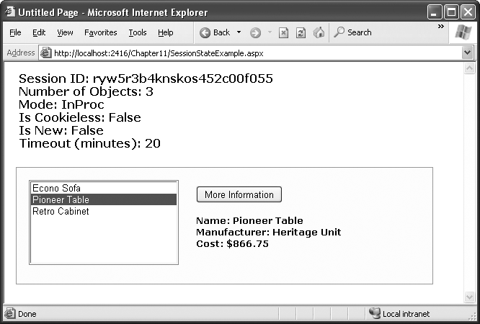
A Session State Example
Anadolu University

Slide 47
Session variable using Javascript:
<script type="text/javascript"> function GetUserName()
{
var username = '<%= Session["UserName"] %>';
alert(username );
}
</script>
Muzaffer DOĞAN - Anadolu University

Slide 48
Application State
Application state allows you to store global objects that can be accessed by any client
Similar to session state
Information is hold on the server
Example: Global counter
Items in application state never time out
They last until the application or server is restarted, or the application domain refreshes itself
Application state isn’t often used
Instead, use web.config file or cache
Anadolu University

Slide 49
Counter Example
protected void Page_Load(Object sender, EventArgs e) {
// Retrieve the current counter value:
int count = 0;
if (Application["HitCounterForOrderPage"] != null)
{
count = (int)Application["HitCounterForOrderPage"];
}
// Increment the counter:
count++;
// Store the current counter value:
Application["HitCounterForOrderPage"] = count;
lblCounter.Text = count.ToString();
}
Anadolu University

Slide 50
References
Beginning ASP.NET 3.5 in C# 2008: From Novice to Professional
MSDN Help
Anadolu University

